Slide 1
Think Again?
The amount of mental simulation tracks uncertainty in the outcome
Jessica Hamrick (Berkeley)
Kevin Smith (UCSD)
Tom Griffiths (Berkeley)
Ed Vul (UCSD)

Slide 2
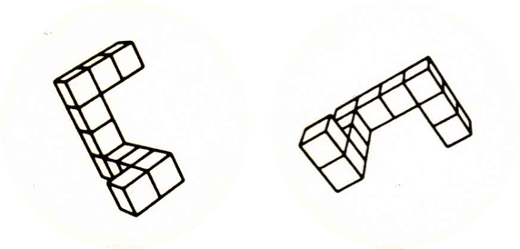

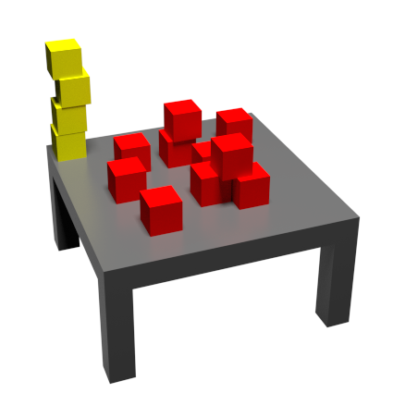
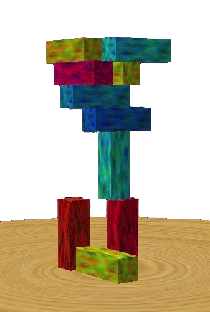
Mental simulation
Shepard & Metzler (1971)
Schwartz & Black (1996)
Battaglia, Hamrick, & Tenenbaum (2013)

Slide 3
How is mental simulation used?
How many simulations do we run?

Slide 4
Hypothesis
More simulations when there is more uncertainty in the outcome.

Slide 5
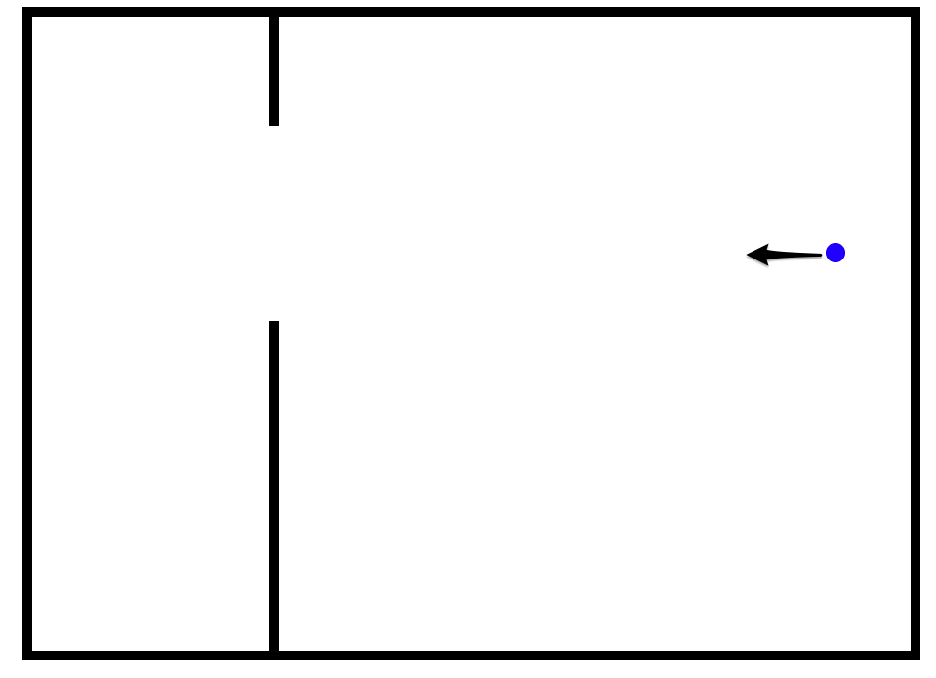

Slide 6
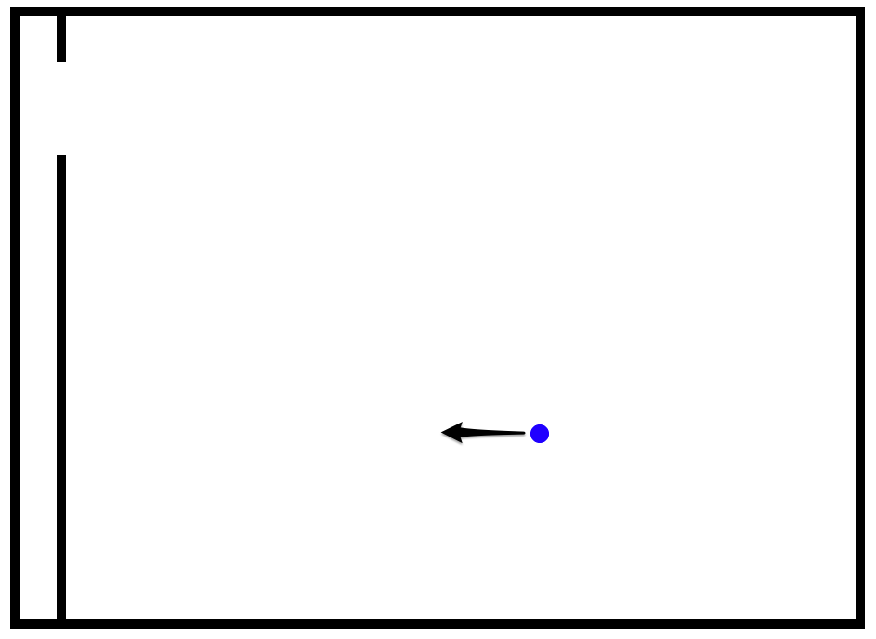

Slide 7
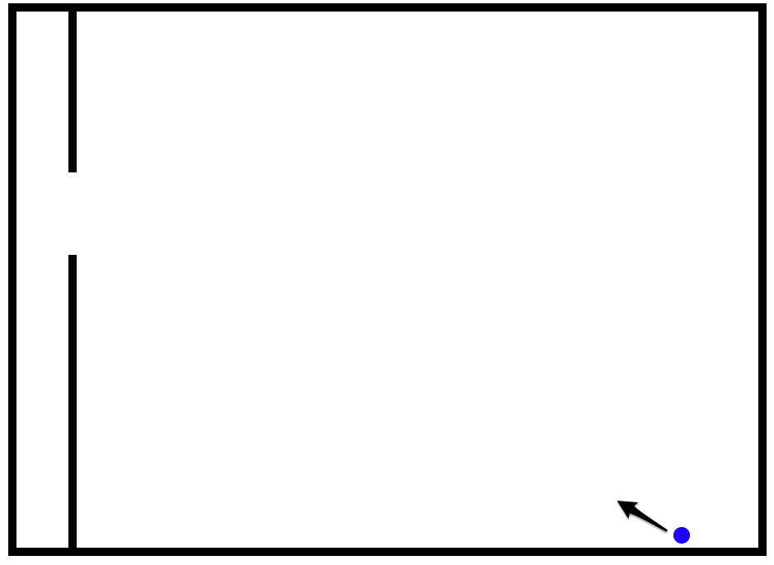

Slide 8
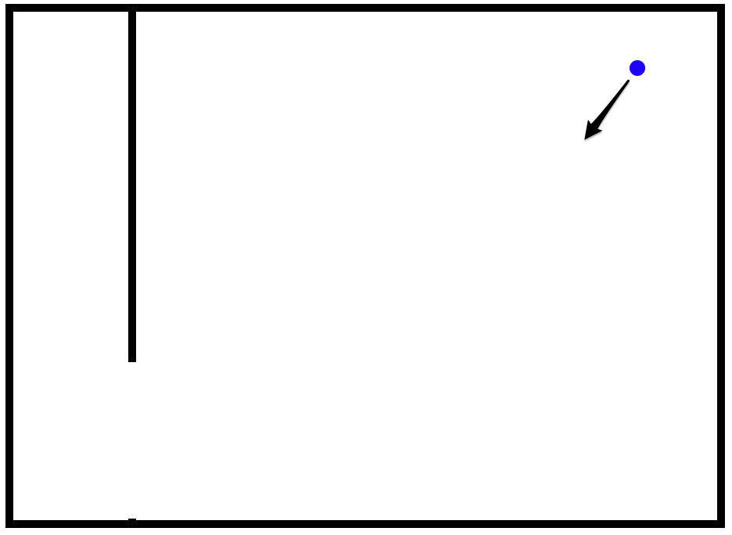

Slide 9
Background
“Noisy Newton” hypothesis
Sanborn, Mansinghka, & Griffiths (2013); Smith & Vul, (2013); Battaglia, Hamrick, & Tenenbaum (2013); many others!

Slide 12
^{Smith & Vul (2013)}

Slide 15
Background
“Noisy Newton” hypothesis
Sanborn, Mansinghka, & Griffiths (2013); Smith & Vul, (2013); Battaglia, Hamrick, & Tenenbaum (2013); many others!
Sequential Probability Ratio Test (SPRT)
Wald (1947)
Gold & Shadlen, 2007; Ratcliff & McKoon, 2008; Bitzer, Park, Blankenburg, & Kiebel, 2014

Slide 16
SPRT with T=2
(goes in)
2
1
0
-1
-2
(does not go in)
^{Wald (1947)}

Slide 17
SPRT Model
Probability of responding “goes in” with sample probability p and threshold T:
Expected number of samples N:
^{Feller (1968, ch. XIV)}

Slide 18
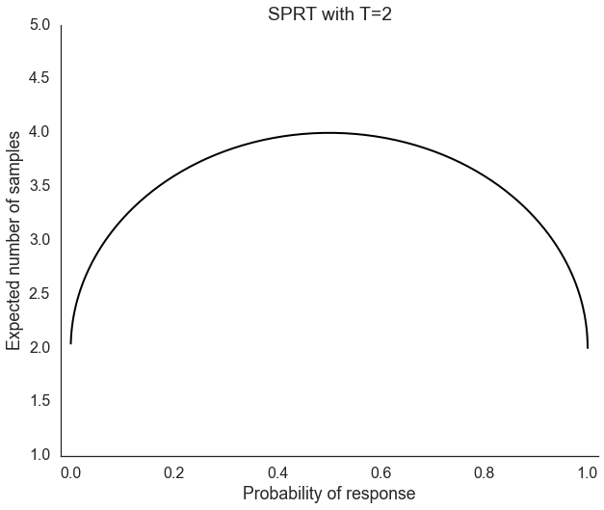

Slide 19
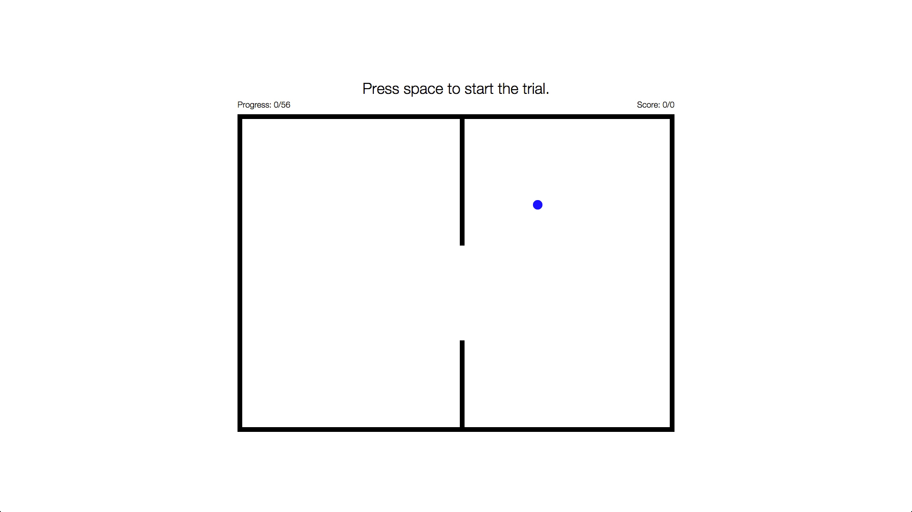

Slide 20
“Will it go in the hole?”
N=320 participants on Mechanical Turk
48 trials per participant
Latin square design w/ 8 conditions:
48 initial animations (16 each of 0, 1, & 2 bounces)
4 trial types
“Far In” (FI) — clearly goes in
“Far Miss” (FM) — clearly misses the hole
“Close In” (CI) — barely goes in
“Close Miss” (CM) — barely misses the hole
2 hole sizes (100px and 200px)

Slide 22
Adjusted SPRT Model
Response time as a function of samples and bounces:
Time to setup the simulation(s)
Time to simulate with no bounces
Time to simulate each bounce
Expected number of bounces
Expected number of samples

Slide 25
How many simulations?
People vary the number of simulations in response to their own uncertainty
Physical simulation as a sampling mechanism
SPRT as a sampling strategy
Simulation + SPRT is well-predictive of both responses and response times

Slide 26
Questions
Why do bounces add an additional time cost above and beyond uncertainty?
What if people are just spending more time per sample, rather than varying samples?
Is the sampling strategy the same in a continuous (rather than 2AFC) domain?

Slide 27

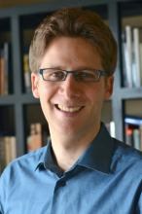
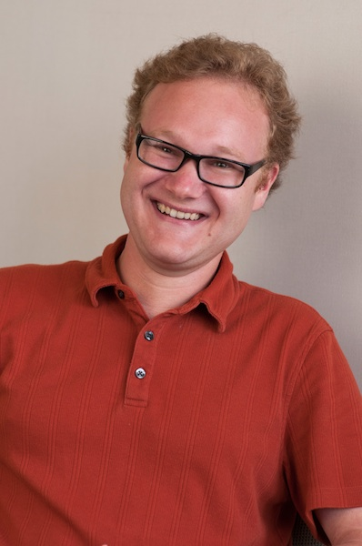
Thanks!
Kevin Smith
Tom Griffiths
Ed Vul
Funding sources:
NSF GRF awarded to JBH
UCSD Chancellors Interdisciplinary Collaboratories grant awarded to KAS
NSF CPS grant 1239323
ONR grant N00014-13-1-0341

